Slide 1
TerrainRover
AI
Group Members:
Ujjwal Mahajan | Kedar Shiralkar | Pankaj Waingade | Atharva Thakur

Slide 2
Table of
CONTENTS
Introduction
Objectives
Workflow
Chassis
Components
Simulation
Prototype
Dataset Collection
Model
Applications
Conclusion

Slide 3
Introduction
The TerrainRover AI project aims to develop a smart car capable of autonomous navigation with real-time terrain awareness. Traditional RC cars lack adaptability to varied terrains, limiting their functionality. This project addresses this limitation by integrating artificial intelligence (AI) for terrain classification and adapting the car's behavior accordingly.
Terrain classification
Speed Control
Motivation
Enhancing the capabilities of cars, making them versatile for exploration, surveillance, and various applications such as defense etc.

Slide 4
Objectives
01
02
03
Design of 3D Prototype of RC Car
Implementation of Terrain Classification System
Speed Control of RC Car using Terrain Detection

Slide 5
Workflow
1
Chassis Design
3D Printing
Acrylic
Assembly
2
Simulation
Components
Calculations
Connections

Slide 6
3
Model Selection
Dataset Collection
Training and Testing
Model Implementation
Interfacing RPi and Arduino

Slide 7
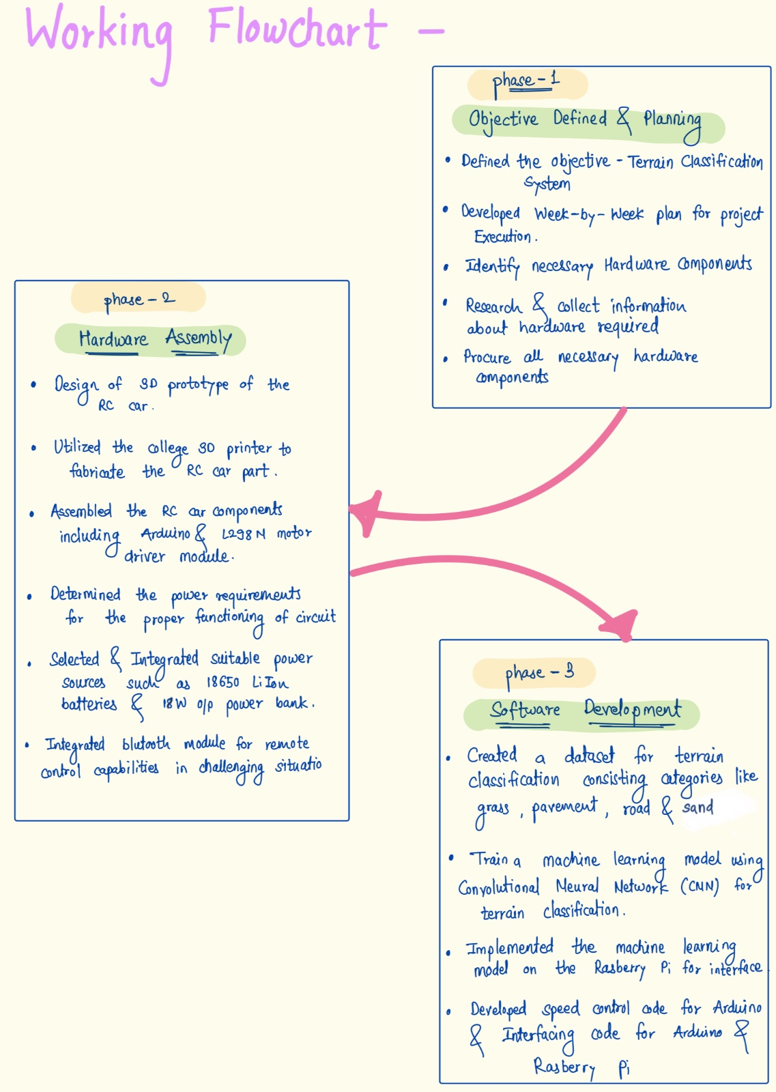
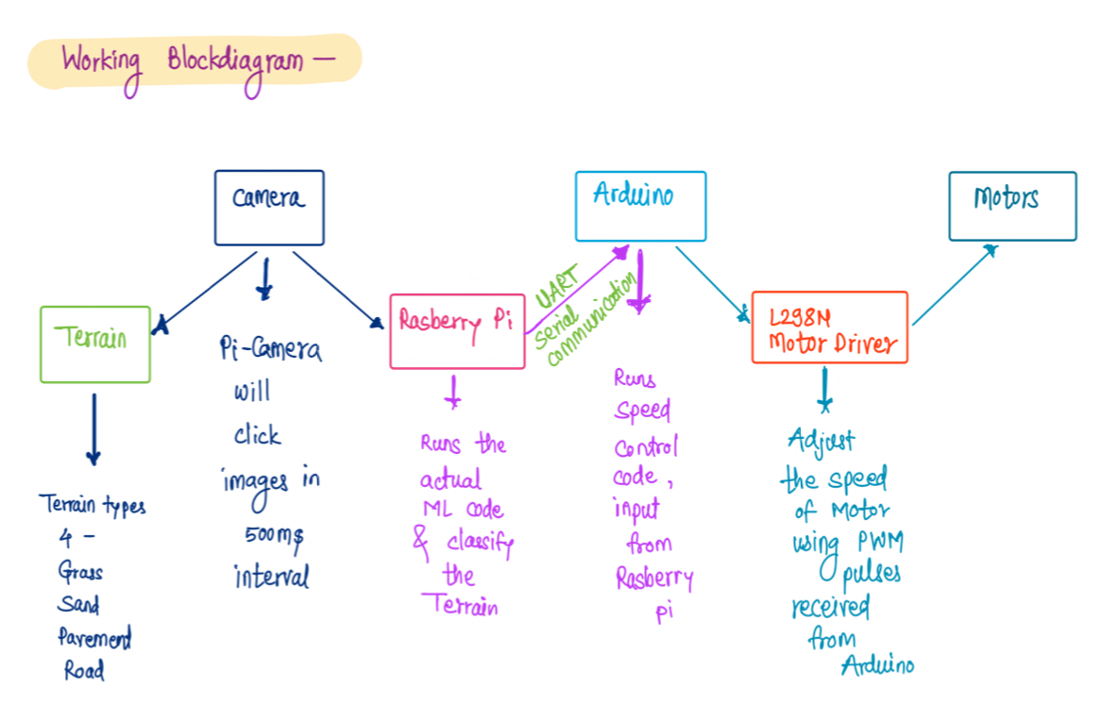

Slide 8
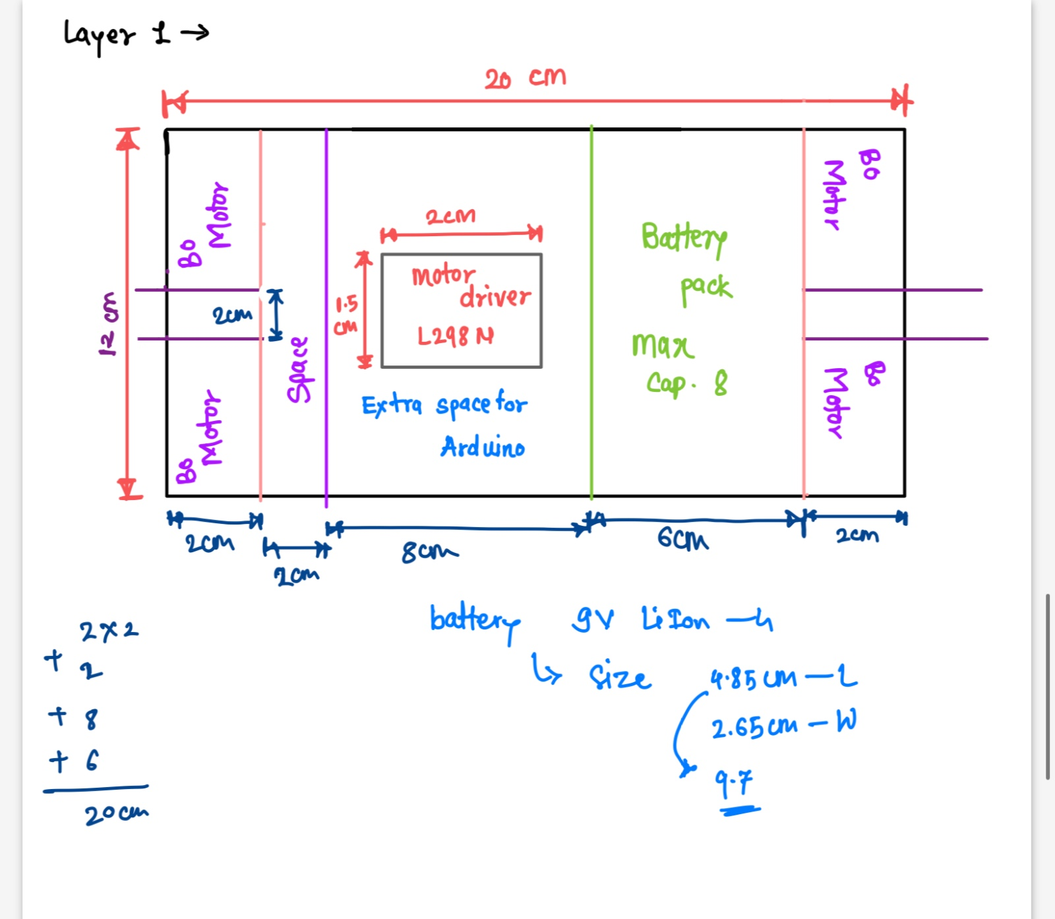
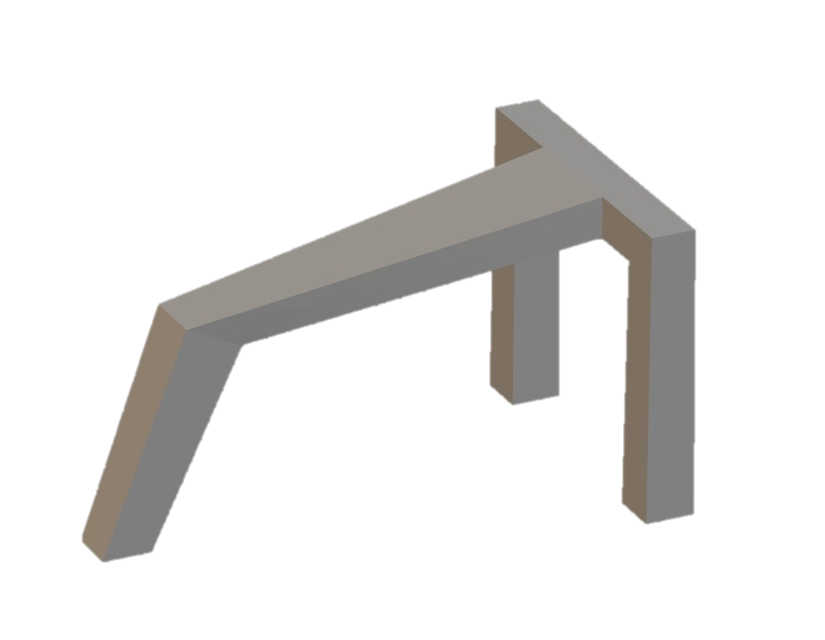
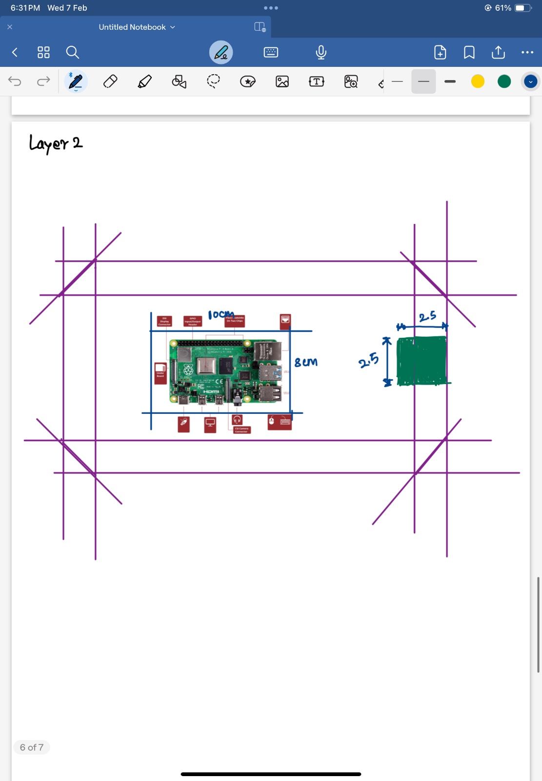
Chassis
Acrylic Sheet as upper base
Wood as lower base
3D Print
3D printed this structure for mounting the camera at a specific angle.

Slide 9
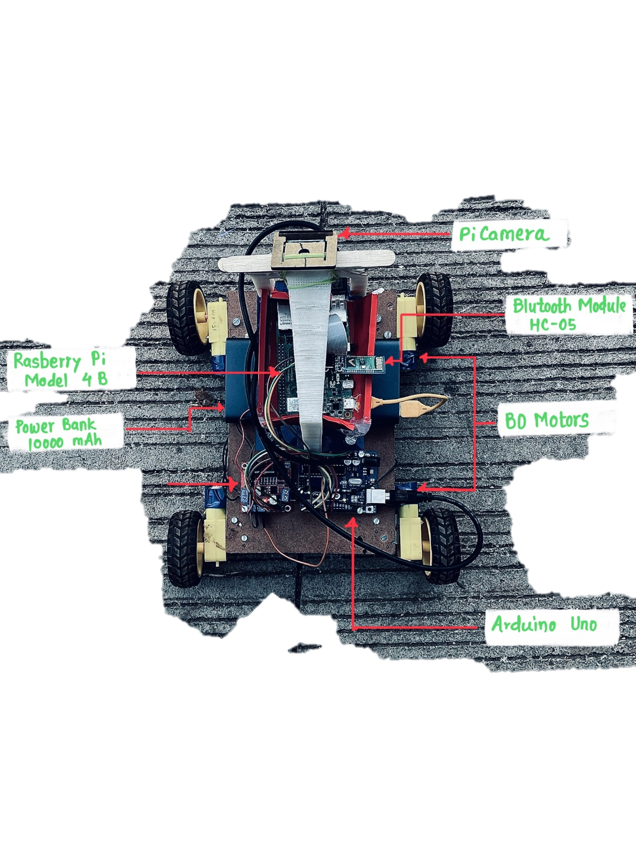
Components

Slide 10
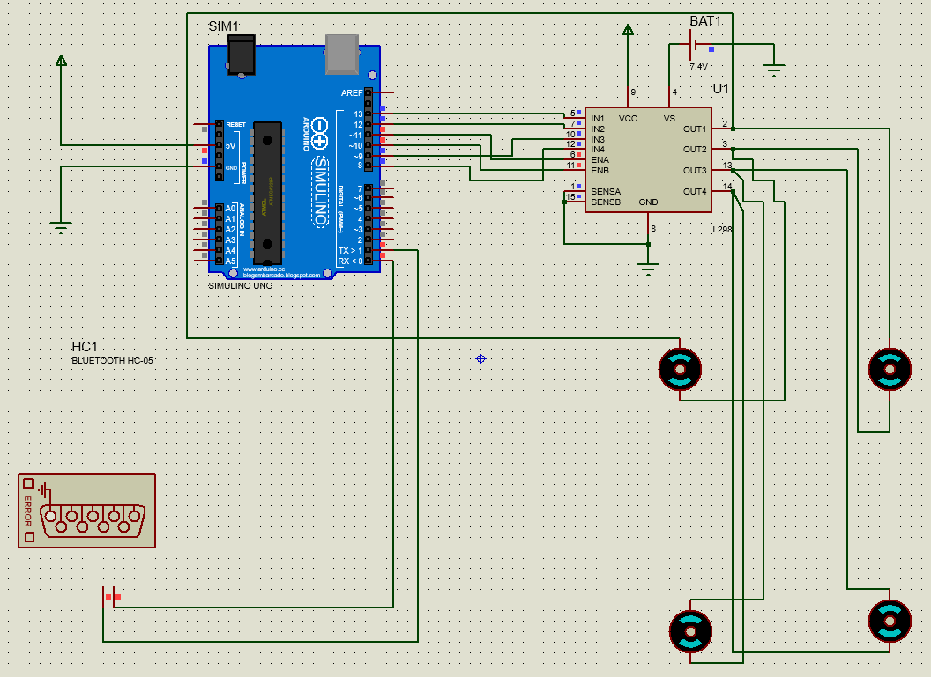
Simulation
Proteus 8.11

Slide 11
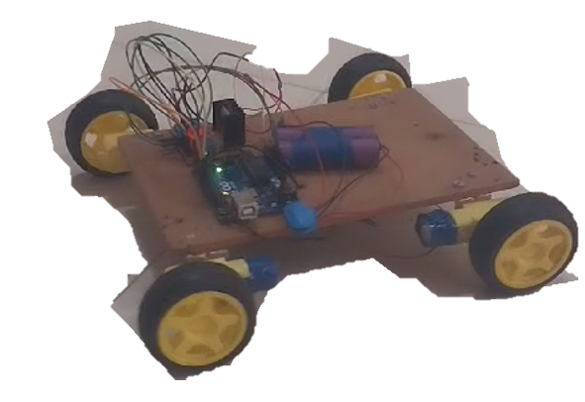
Prototype
Initial Testing

Slide 12
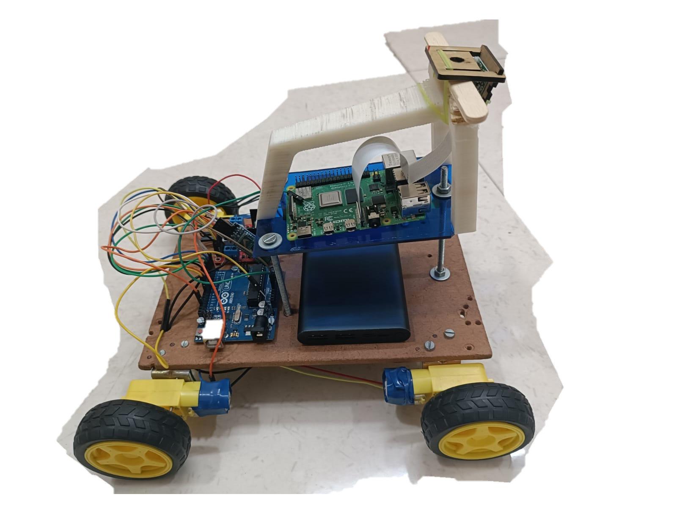
Prototype
Final

Slide 13
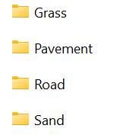
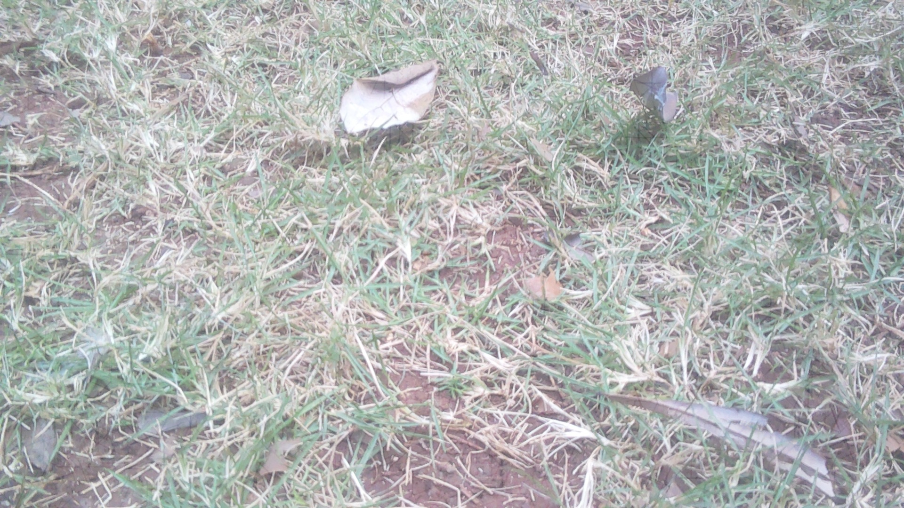
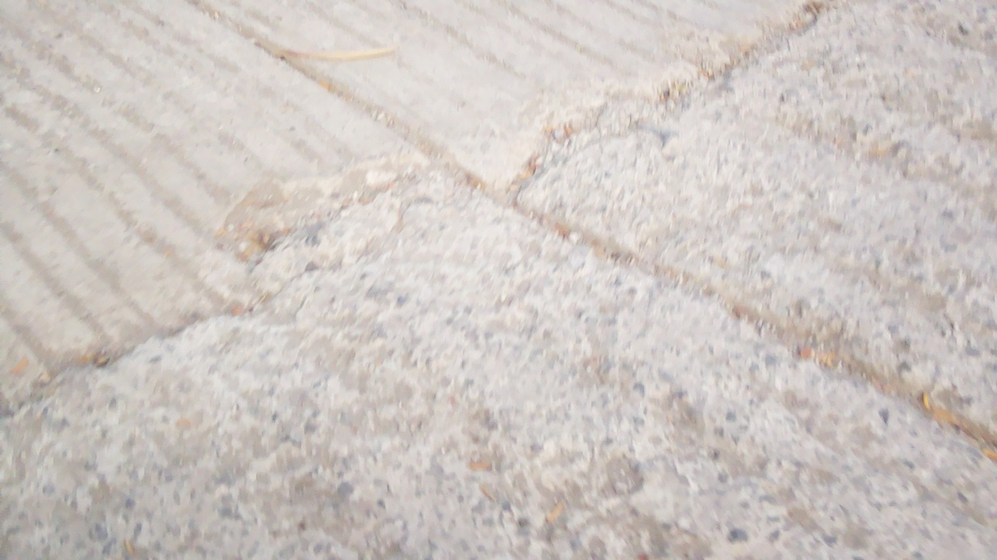
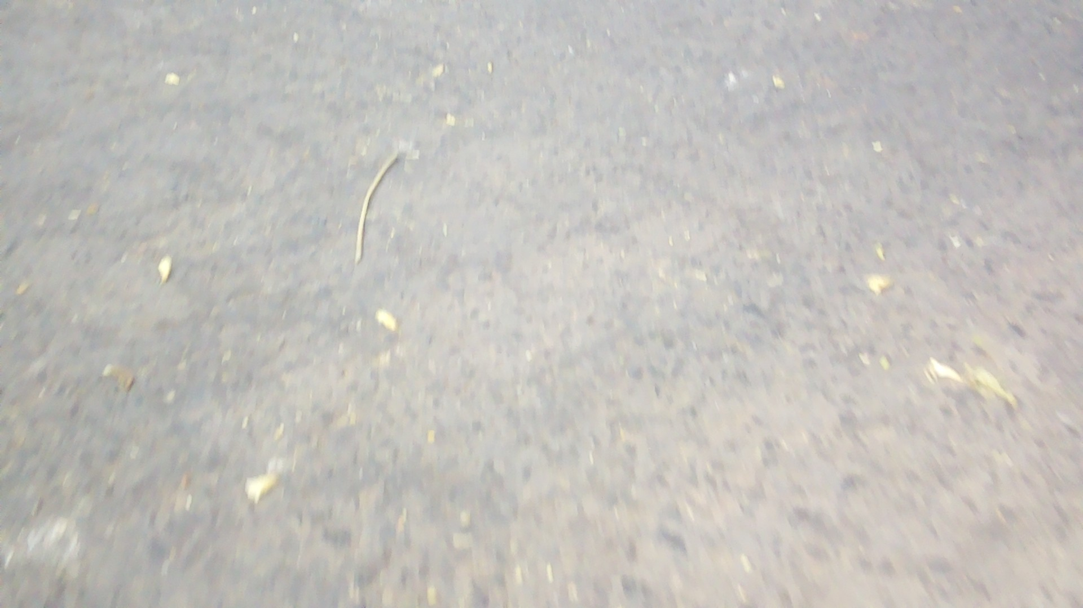
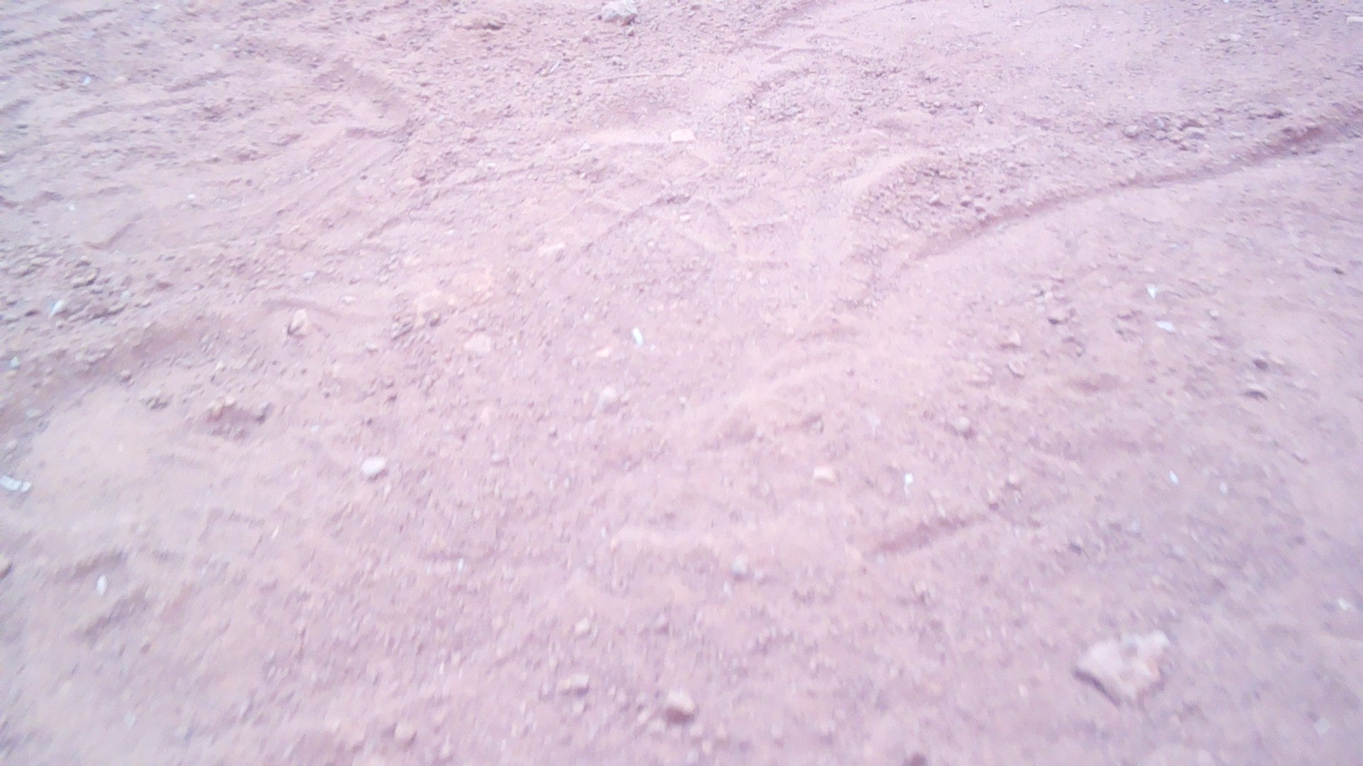
Dataset Collection
Train Set
Test Set
600
400
1000 for every terrain
GRASS
PAVEMENT
ROAD
SAND

Slide 14
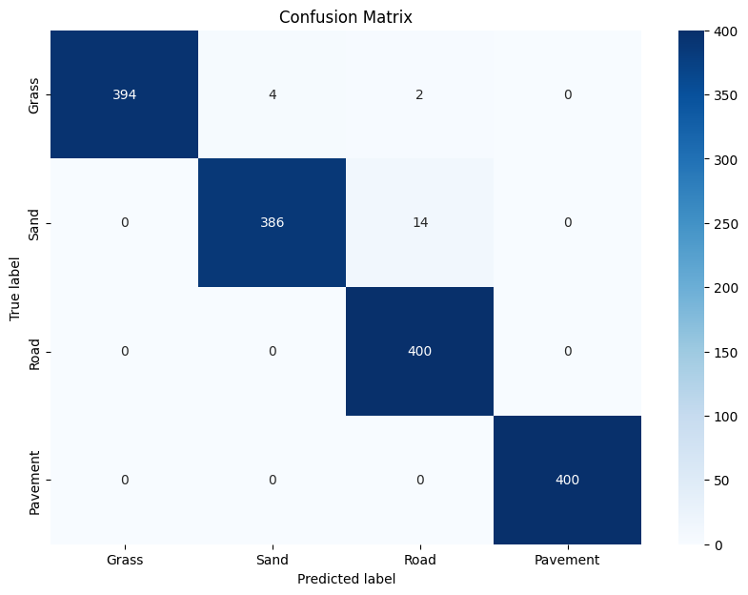
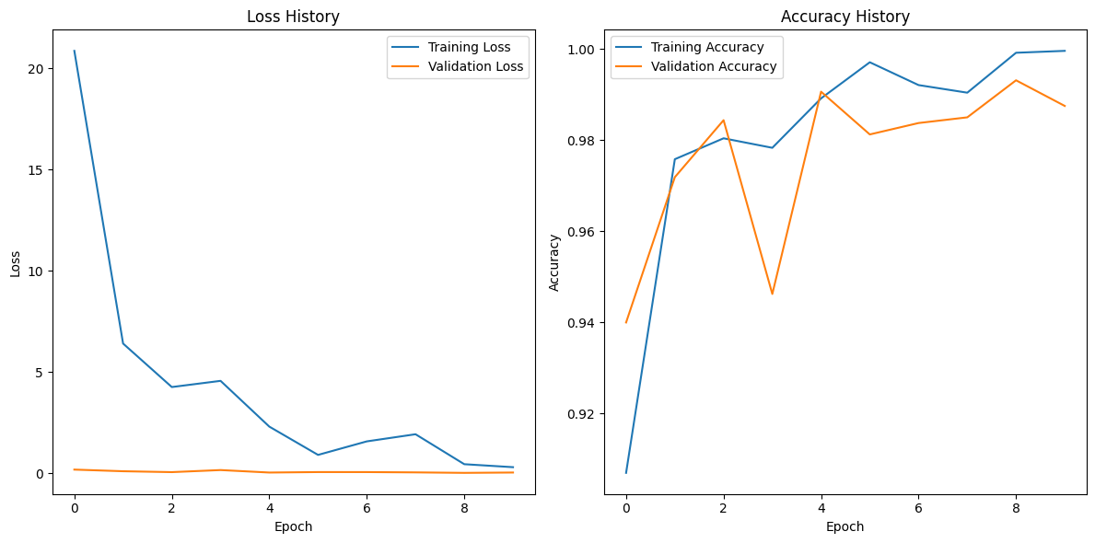
Model
Train Accuracy
99.92%
99.31%
Test Accuracy

Slide 15
CNN Model Approach | Latency on Raspberry Pi | Corrections made compared to the previous model
1. | 370 ms
2. | 360 ms | Increased the number of epochs from 25 to 40 to find the accuracy saturation point.
3. | 350 ms | Increased learning rate from 0.001 to 0.005 and changed kernel size for pooling.
4. | 8 ms | Removed dropout layers, changed input image size from (224,224) to (32,32), reduced the number of pooling layers due to simpler architecture and lesser input parameters.
Testing Accuracy
89.69%
94.33%
96.56%
99.31%

Slide 16
Real-Time Script
5.
Data is sent to model and O/P is generated
3.
Real time Image Capture
6.
Sent to Arduino via serial
communication
1.
Importing Libraries
4.
2.
Data Transformations
(resizing, etc.)
Model Loading(CNN)

Slide 17
Applications
01
02
03
In Autonomous Vehicles
In Military Systems
In Space Rovers
04
05
06
In Agricultural Technology
In Search and Rescue Operations
In Geology and Environmental Monitoring

Slide 18
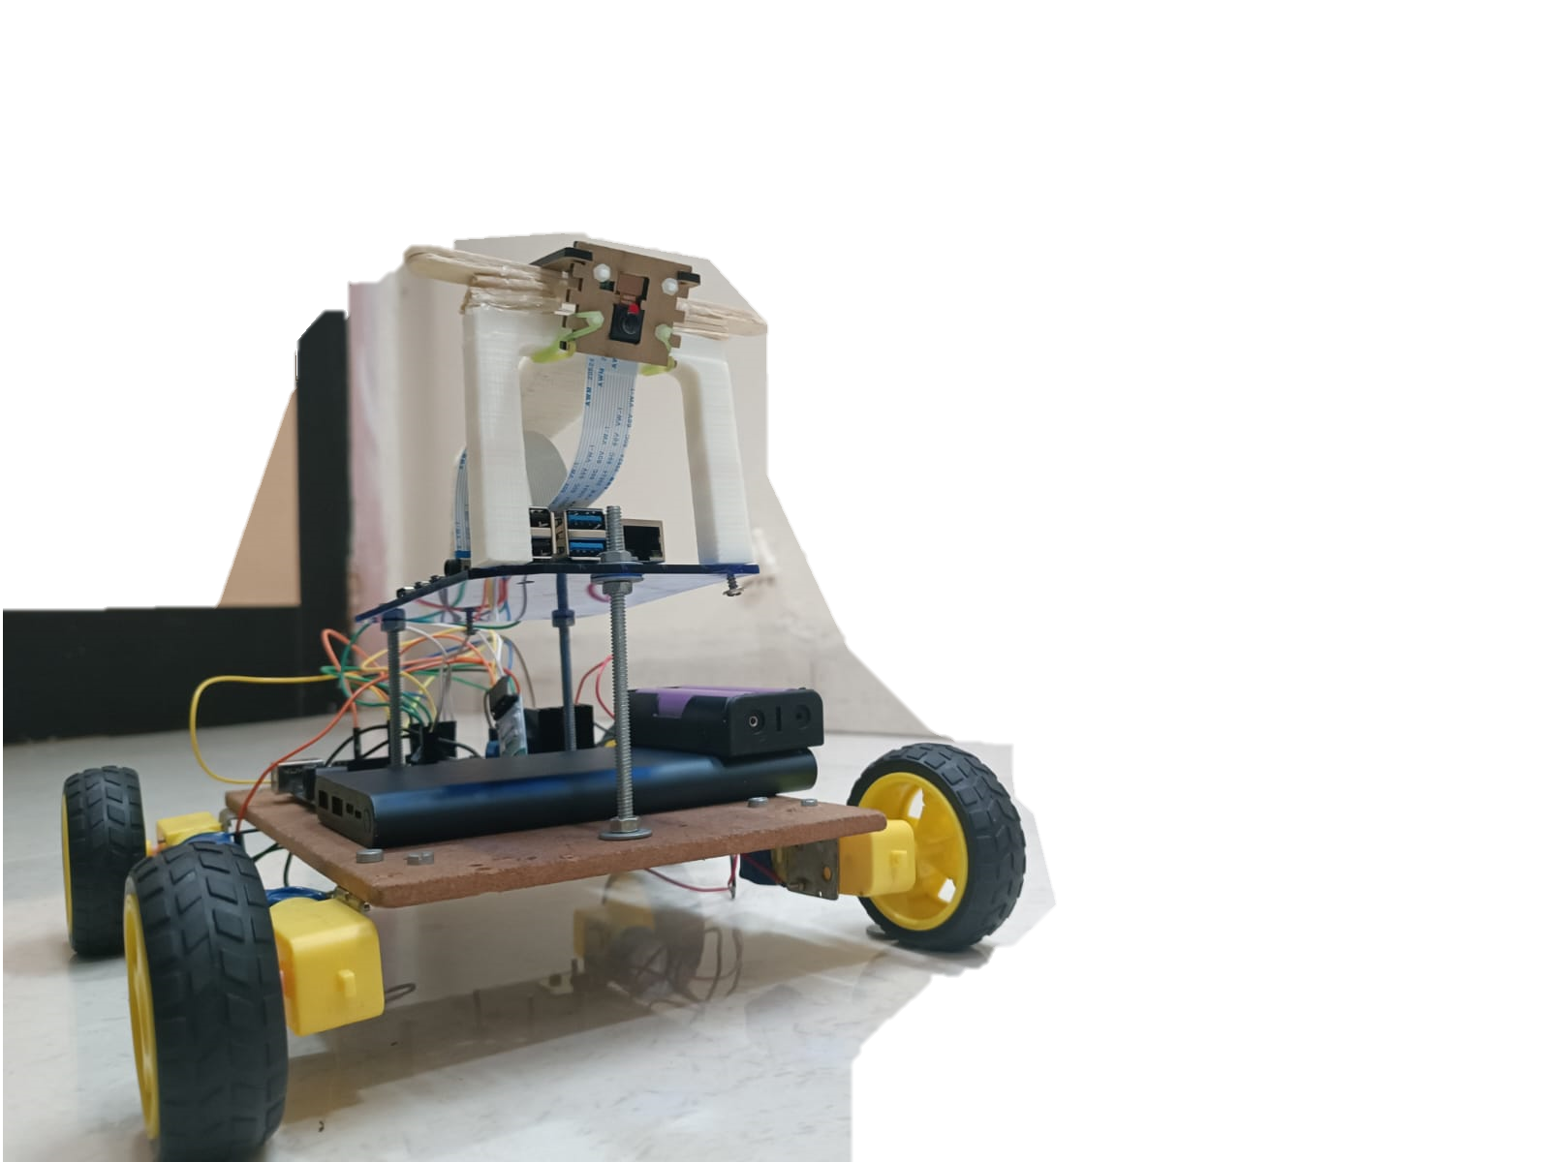
Conclusion
The TerrainRover AI is a low-cost prototype now capable of detecting terrain types with 99.31% accuracy with just an 8ms latency in real-time and implementing speed control for various terrain types along with the ability to be controlled manually via Bluetooth on a smartphone app.

